Slide 1
Office 365 development

Slide 2
Getting started with Office add-ins
</>

Slide 3
Agenda
Intro the add-in model
Office add-ins
Getting started

Slide 4
Developer vision
USERS
DATA
HTML

Slide 5
Intro to the Office add-ins

Slide 6
Introducing the add-in model
Intro to the Office add-ins
Office add-ins do not “live” on the Office client
Custom code executes in the client, cloud, or on-premises
Acquire add-ins via centralized location
Add-in catalog (SharePoint or FileShare)
Public store (via submission process)
APIs for manual deployment

Slide 7





Modern add-in development
Intro to the Office add-ins
Products and platforms
Add-ins
Services and data
Expense
calculator
Vacation
request
Event
planning
Help-desk
support
Learning management
Risk
management
Add-in catalog and store

Slide 8
Demo Adding your first add-in
Intro to the Office add-ins

Slide 9
Office add-ins
Office add-in samples
http://dev.office.com/

Slide 10
Office 2013/2016 development scenarios
Office add-in samples
Web and cross-device ready
Integrate rich web content in Office content
Include contextual content within Office add-ins
Pre-Office 2013
Office 2013/2016
Extending Office ribbon
COM add-in
Extending Office ribbon
COM add-in
Office add-ins
SharePoint add-ins
Macro
VSTO
Macro
VSTO
Document template
http://dev.office.com/

Slide 11
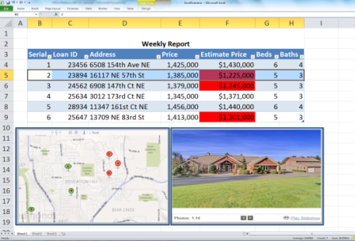

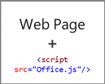
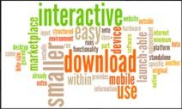

Anatomy
Office add-in samples
Web server
Office Store or SharePoint add-in catalog

Slide 12
Office add-ins A new way to build extensions for Office
Office add-in samples
Contextual mail add-in
Add-in launched contextually from a mail message or appointment
Outlook and Outlook Web Access (OWA)
Task pane add-in
Add-in that runs beside a document/mail with read/write access
Word, Excel, PowerPoint, Project, Outlook
Content add-in
Add-in that runs within a document content with read/write access
Excel, PowerPoint, Access
Add-in command
Command in the Office UI to launch add-in or perform UI-less operation
Outlook and Outlook Web Access (OWA)

Slide 13
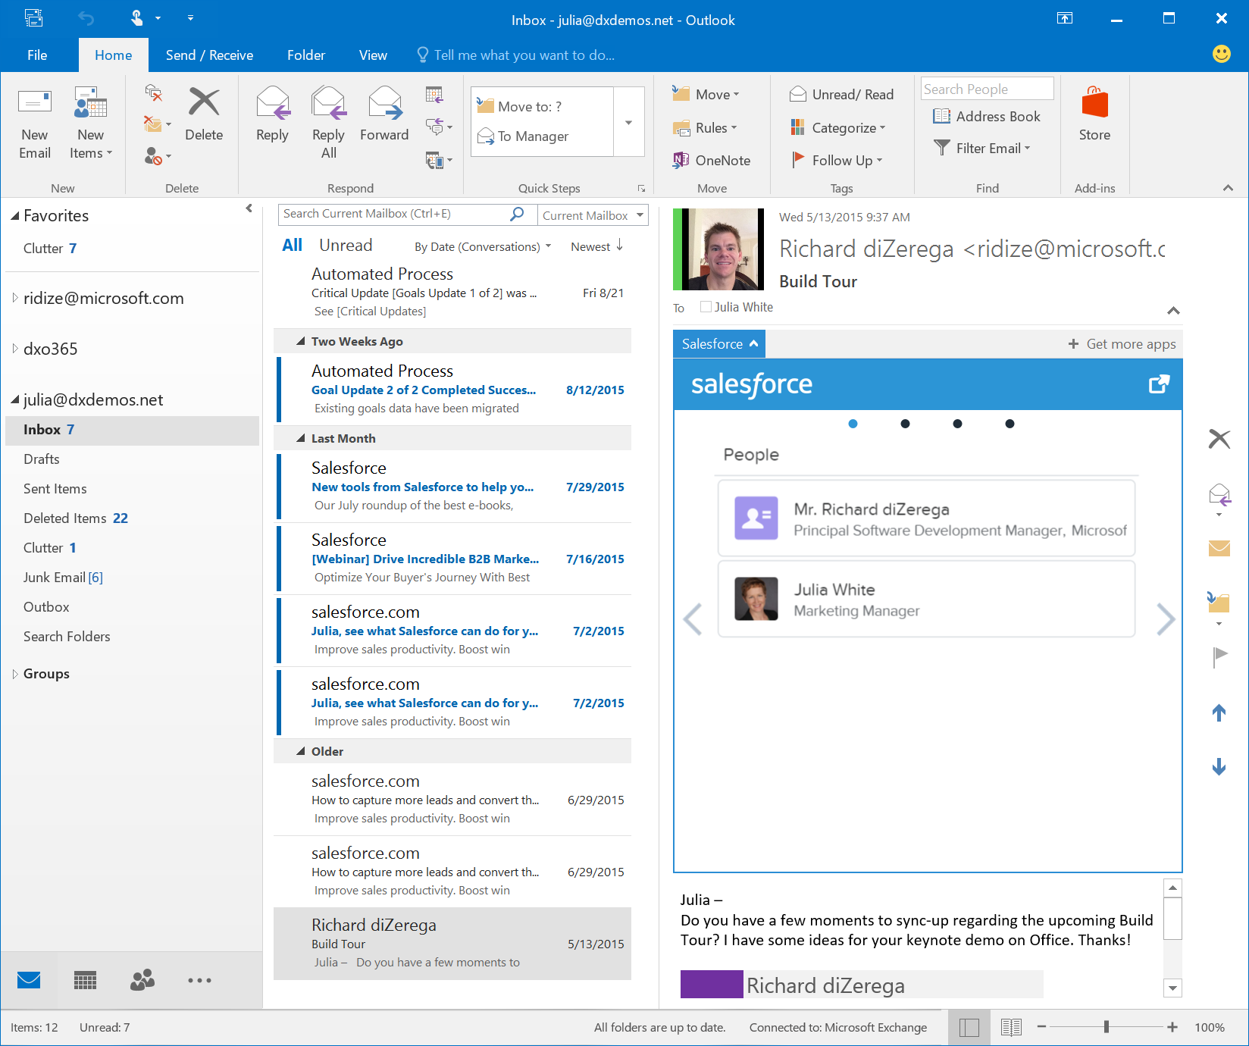
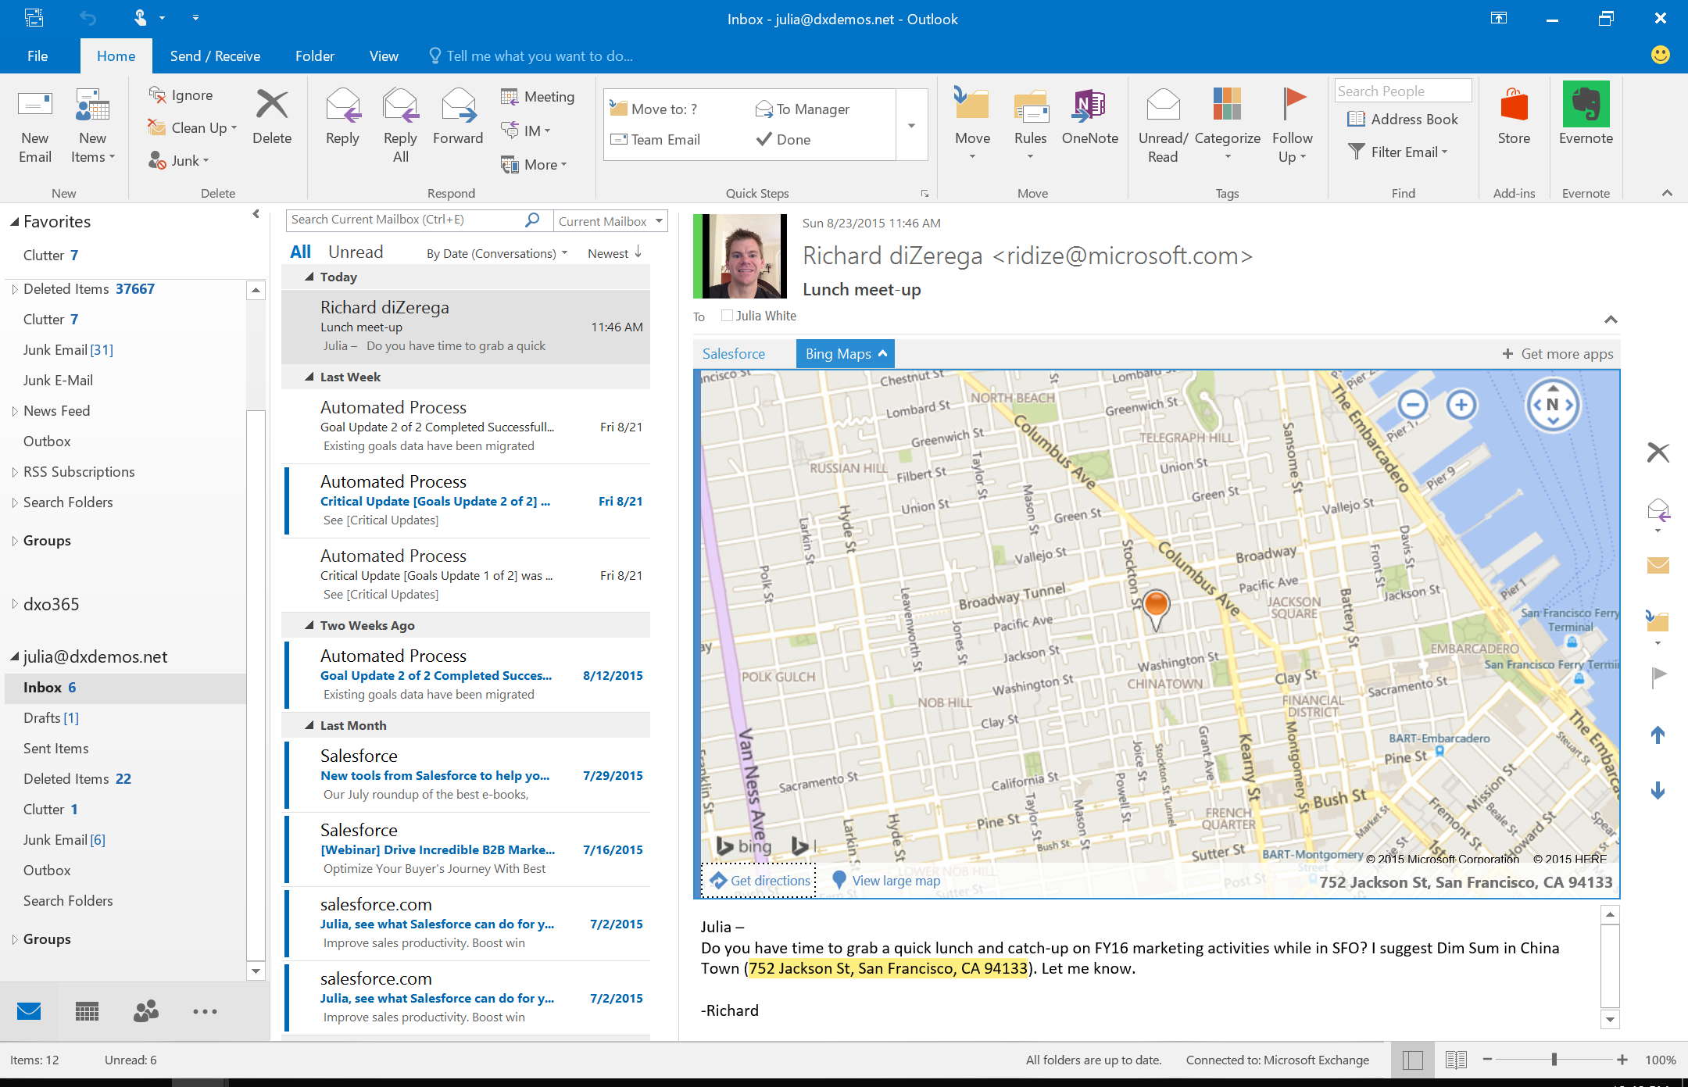
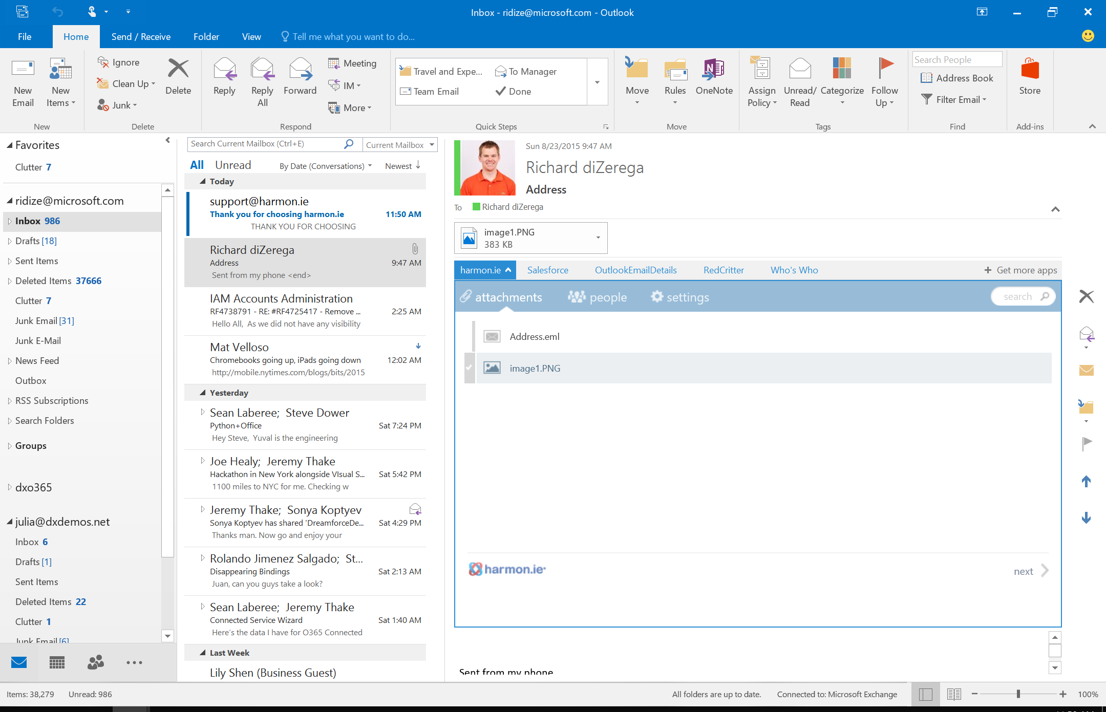
Contextual mail add-in
Office add-in samples

Slide 14
Office add-ins A new way to build extensions for Office
Office add-in samples
Contextual mail add-in
Add-in launched contextually from a mail message or appointment
Outlook and Outlook Web Access (OWA)
Task pane add-in
Add-in that runs beside a document/mail with read/write access
Word, Excel, PowerPoint, Project, Outlook
Content add-in
Add-in that runs within a document content with read/write access
Excel, PowerPoint, Access
Add-in command
Command in the Office UI to launch add-in or perform UI-less operation
Outlook and Outlook Web Access (OWA)

Slide 15
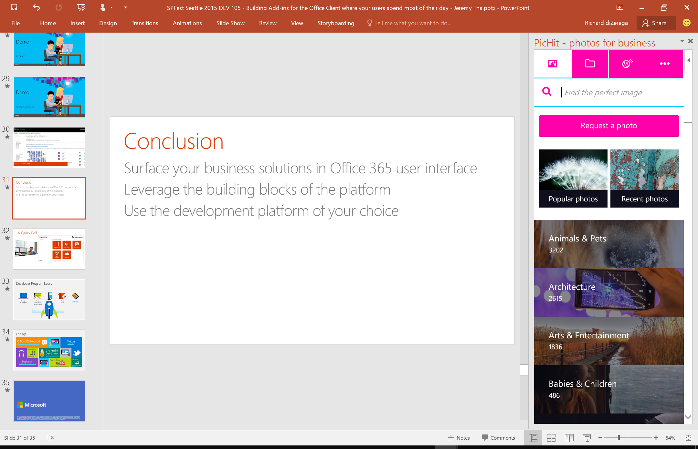
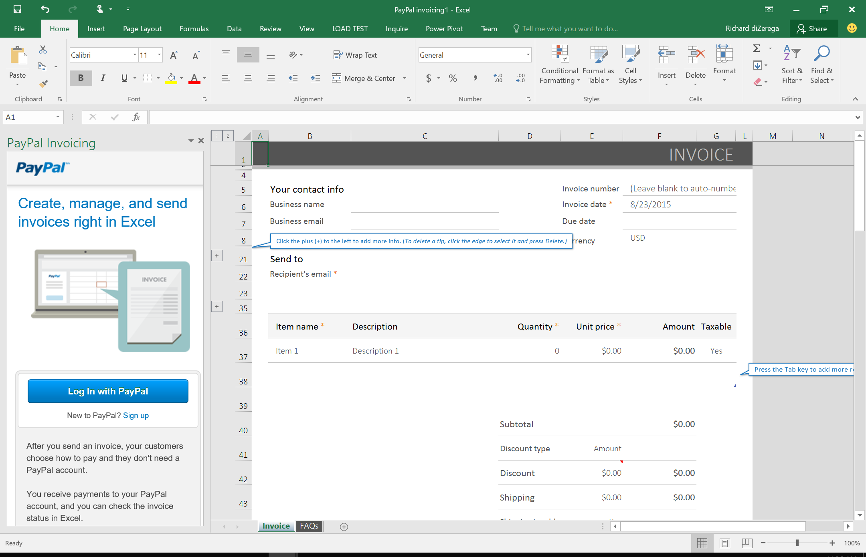
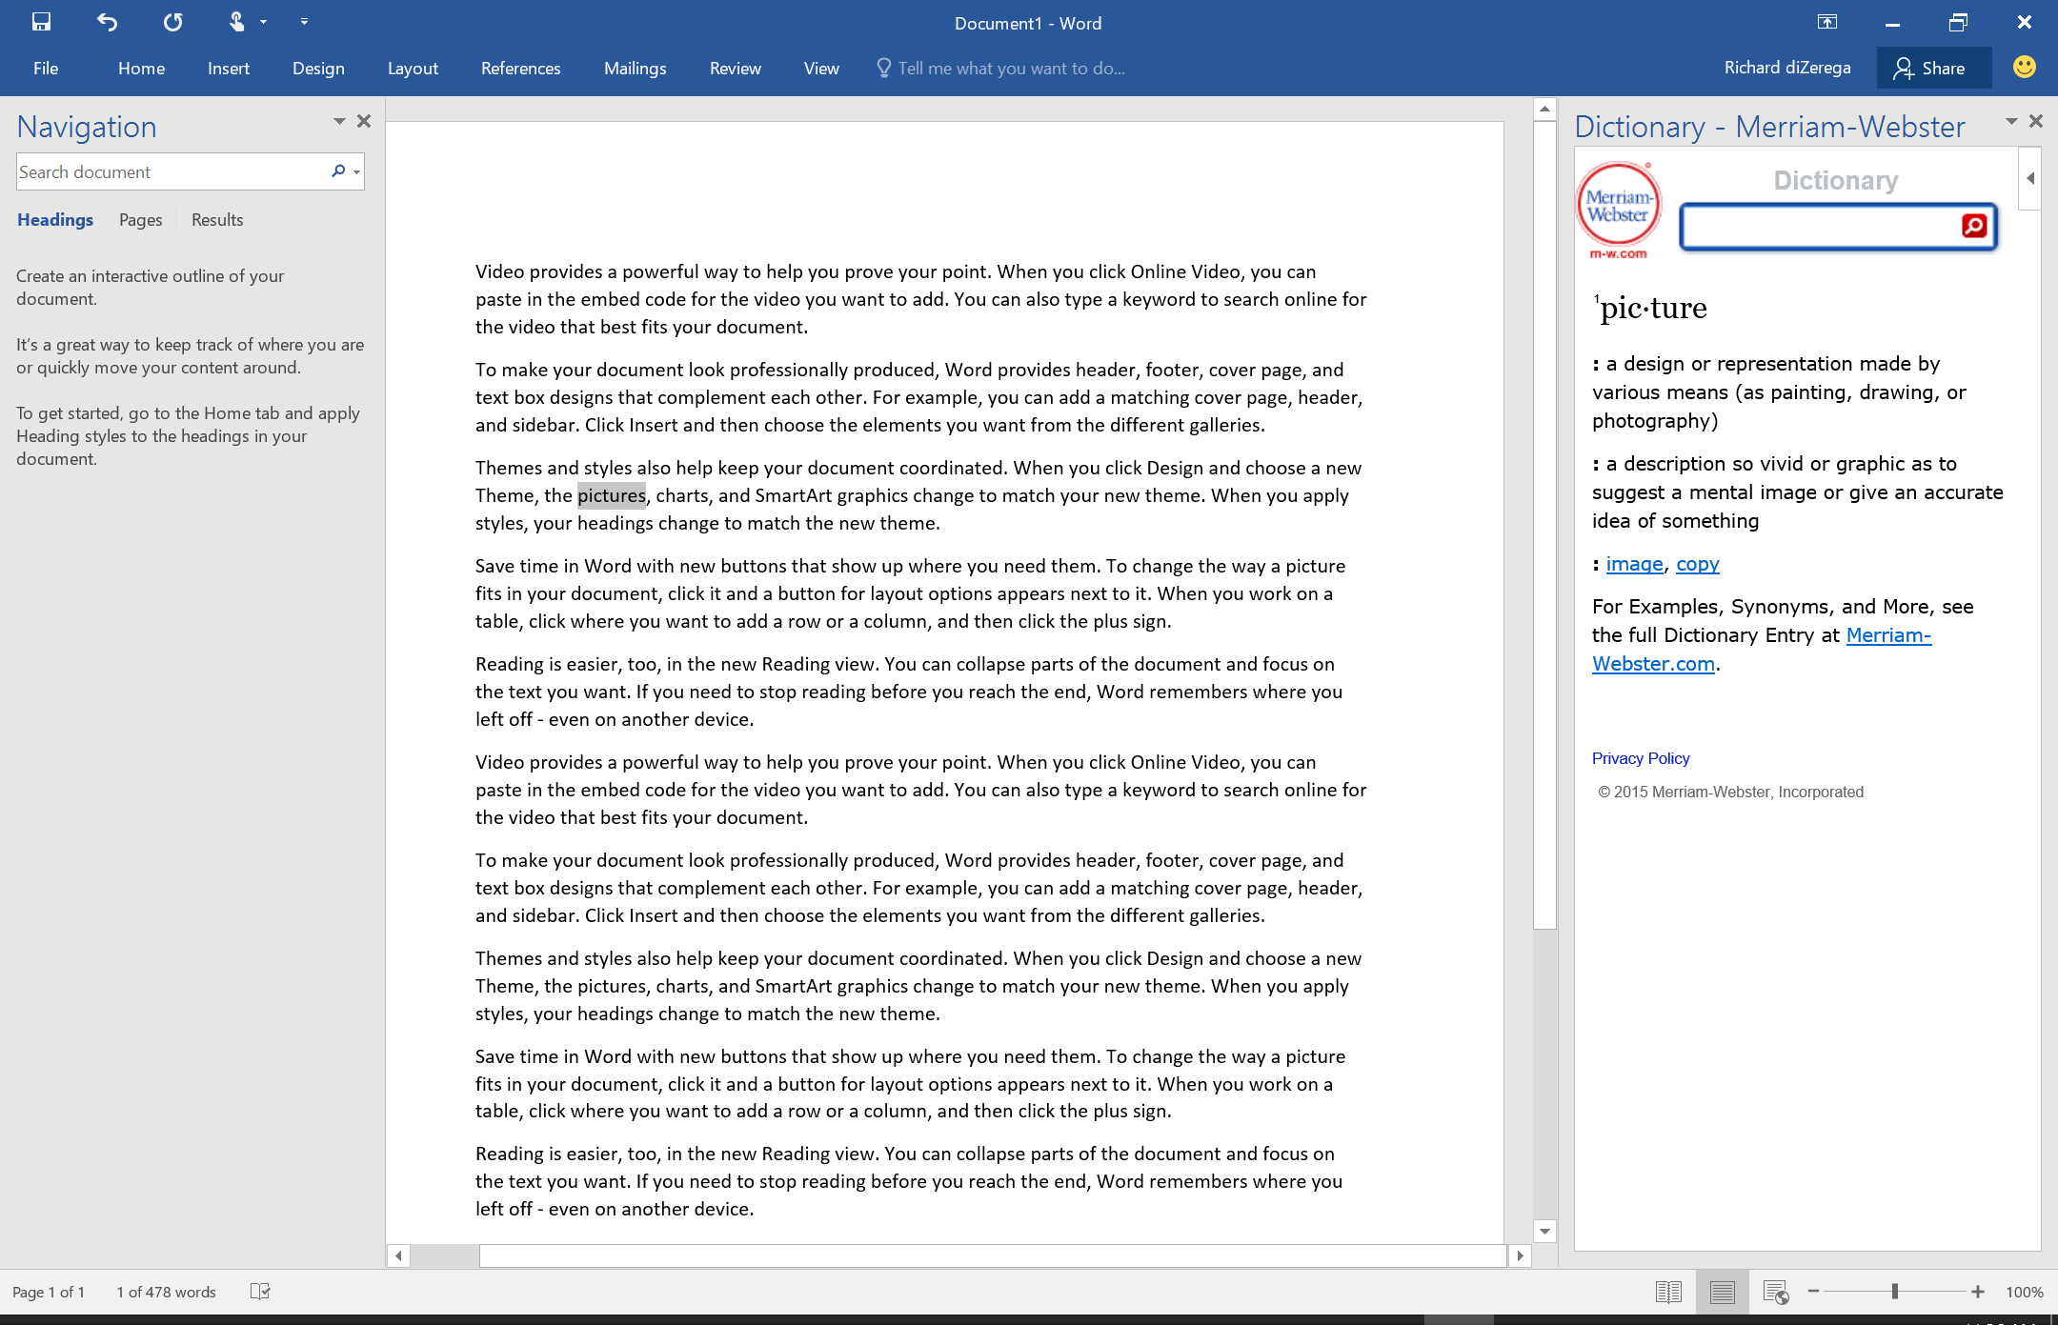
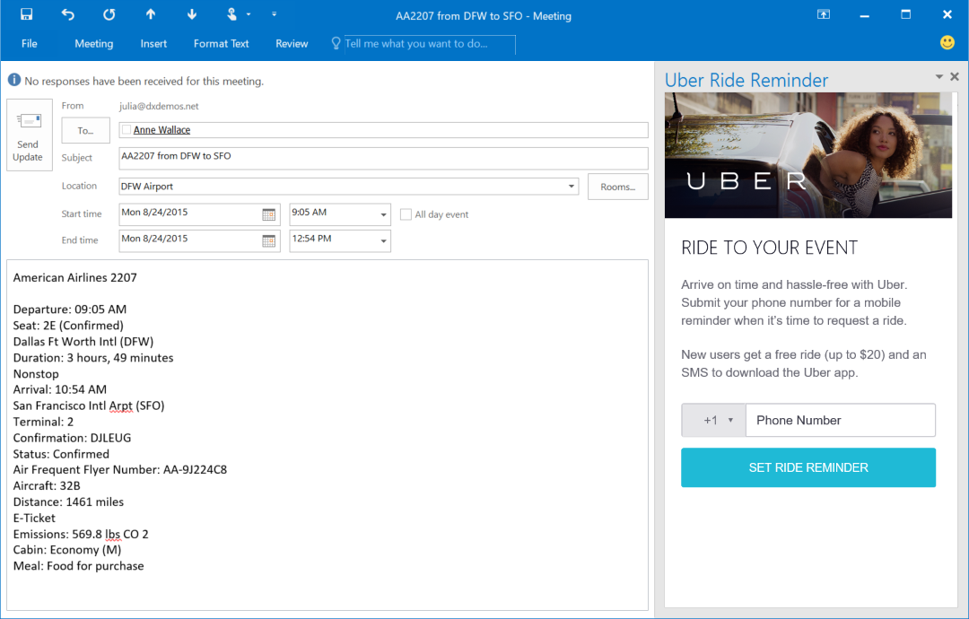
Task pane add-in
Office add-in samples

Slide 16
Office add-ins A new way to build extensions for Office
Office add-in samples
Contextual mail add-in
Add-in launched contextually from a mail message or appointment
Outlook and Outlook Web Access (OWA)
Task pane add-in
Add-in that runs beside a document/mail with read/write access
Word, Excel, PowerPoint, Project, Outlook
Content add-in
Add-in that runs within a document content with read/write access
Excel, PowerPoint, Access
Add-in command
Command in the Office UI to launch add-in or perform UI-less operation
Outlook and Outlook Web Access (OWA)

Slide 17
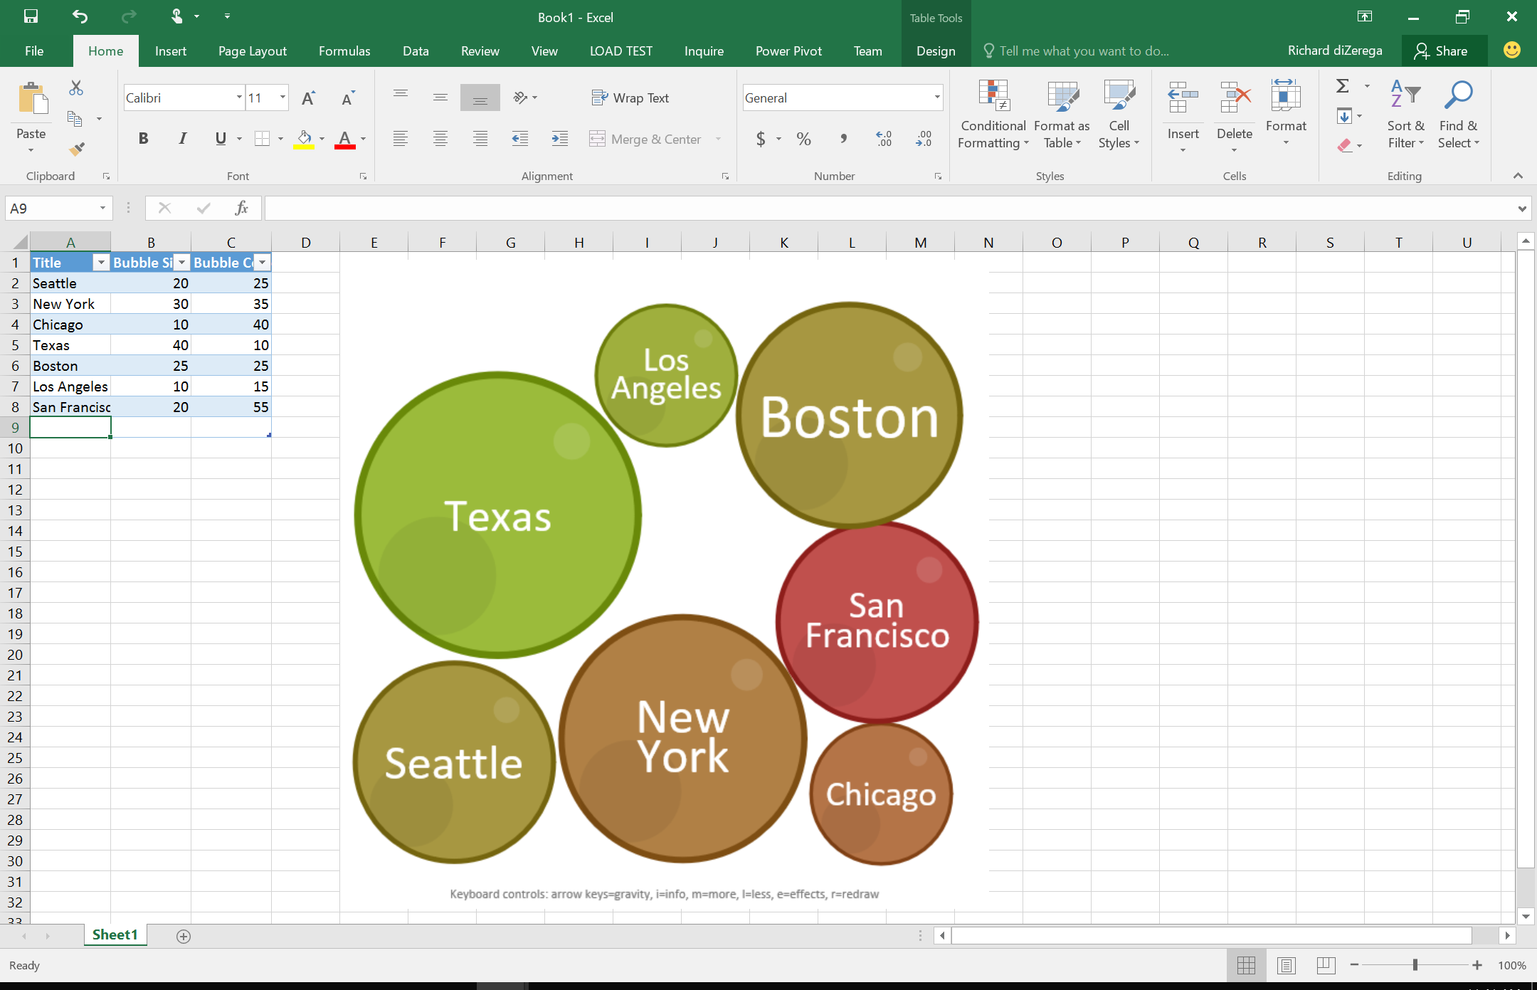
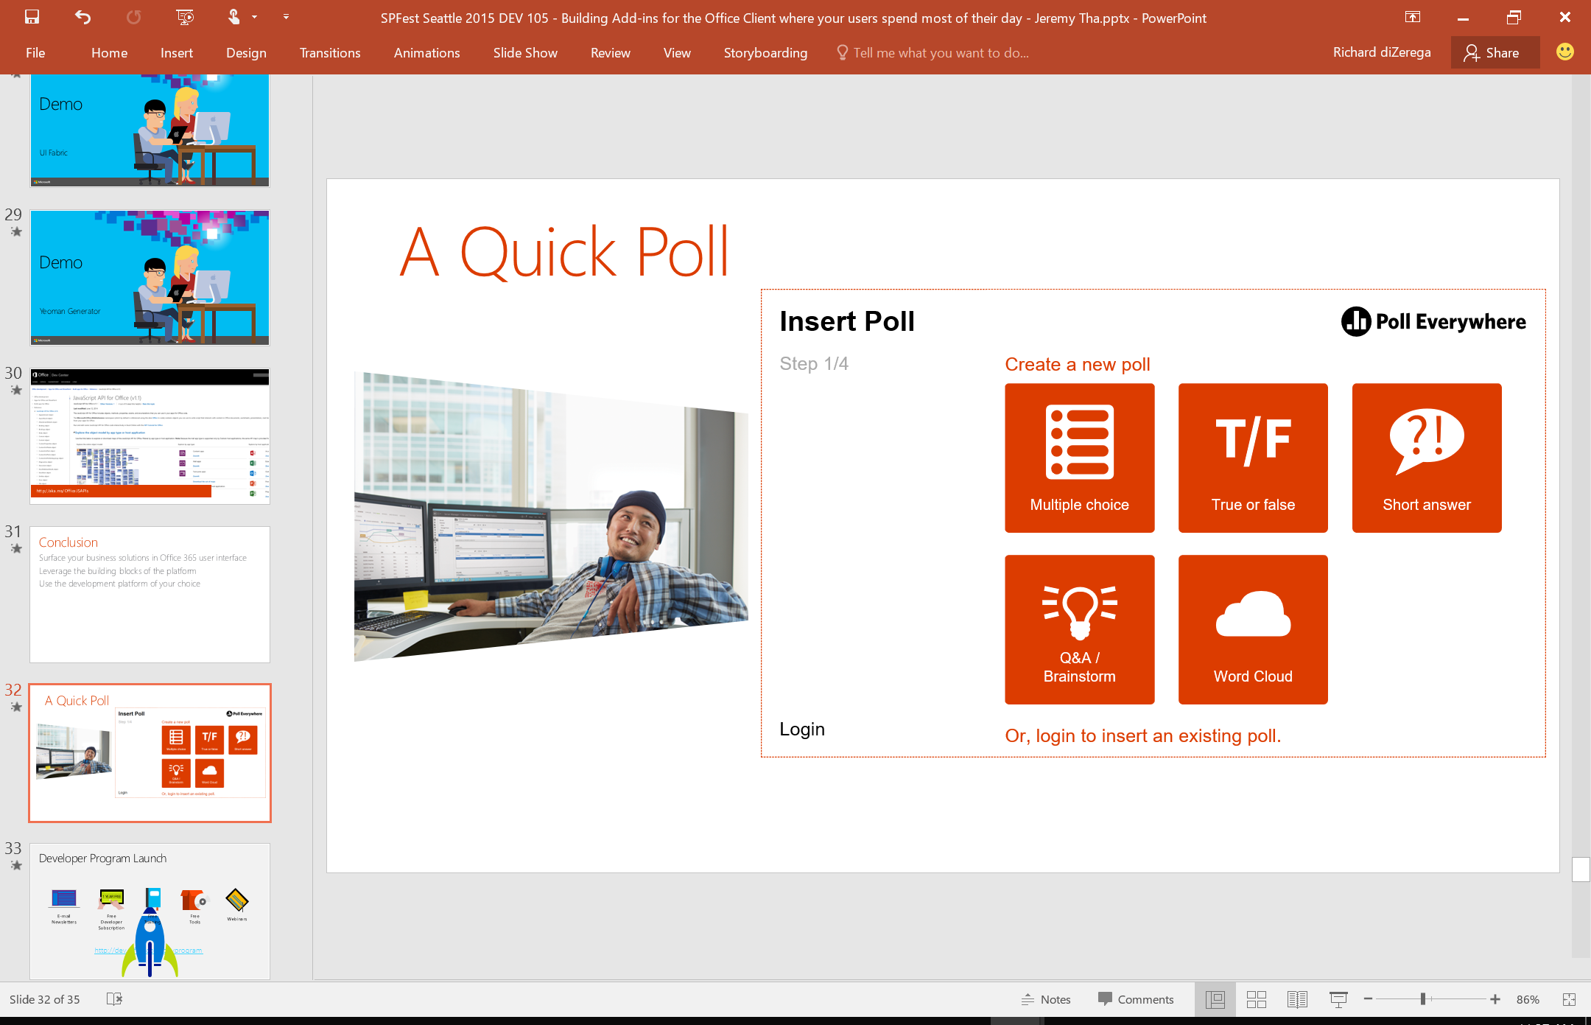
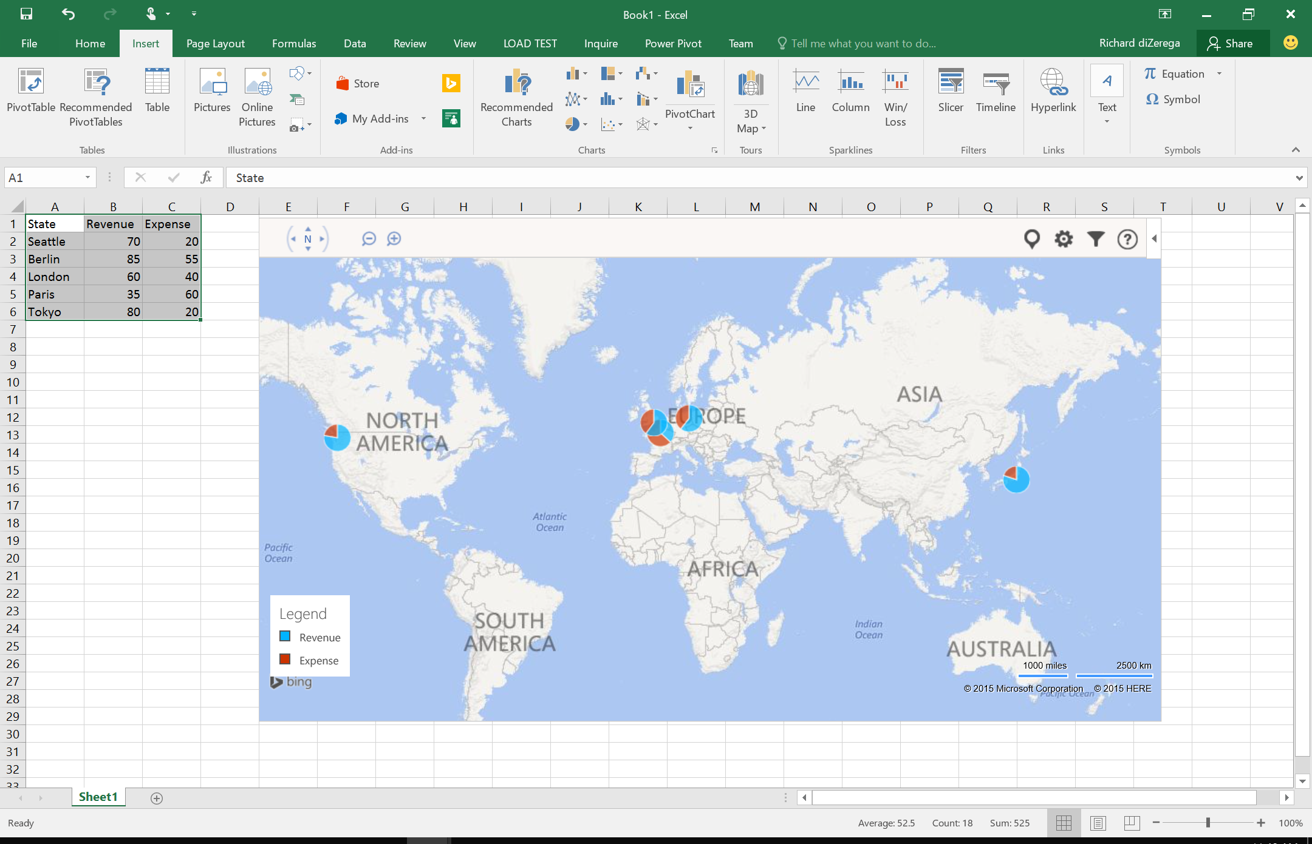
Content add-in
Office add-in samples

Slide 18
Office add-ins A new way to build extensions for Office
Office add-in samples
Contextual mail add-in
Add-in launched contextually from a mail message or appointment
Outlook and Outlook Web Access (OWA)
Task pane add-in
Add-in that runs beside a document/mail with read/write access
Word, Excel, PowerPoint, Project, Outlook
Content add-in
Add-in that runs within a document content with read/write access
Excel, PowerPoint, Access
Add-in command
Command in the Office UI to launch add-in or perform UI-less operation
Outlook and Outlook Web Access (OWA)

Slide 19
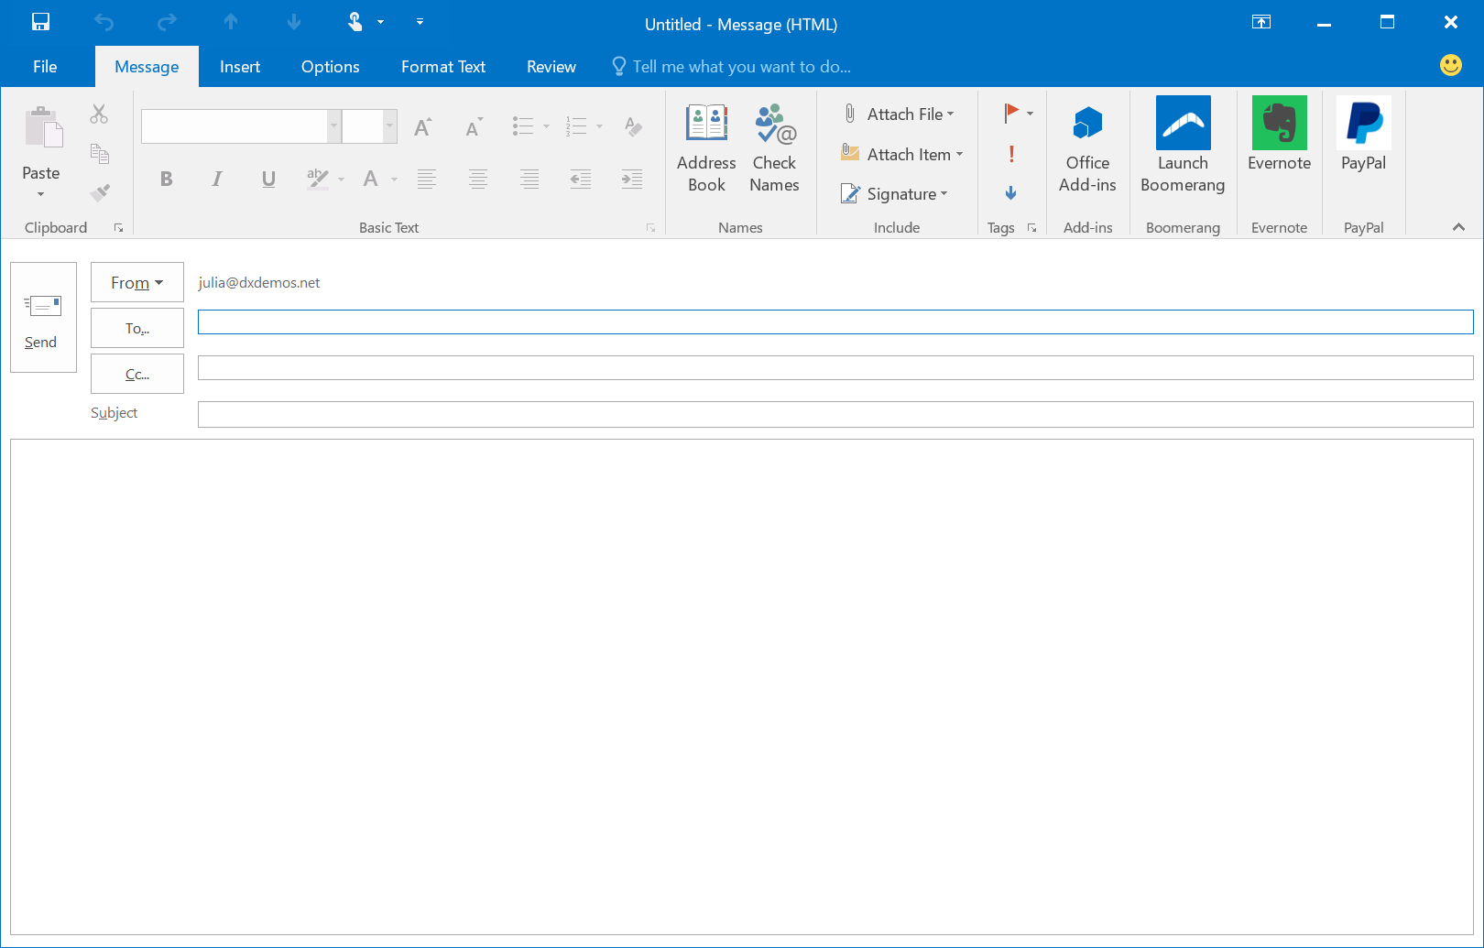
Add-in command
Office add-in samples

Slide 20
Demo Office add-in samples

Slide 21
Getting started
Getting started

Slide 22
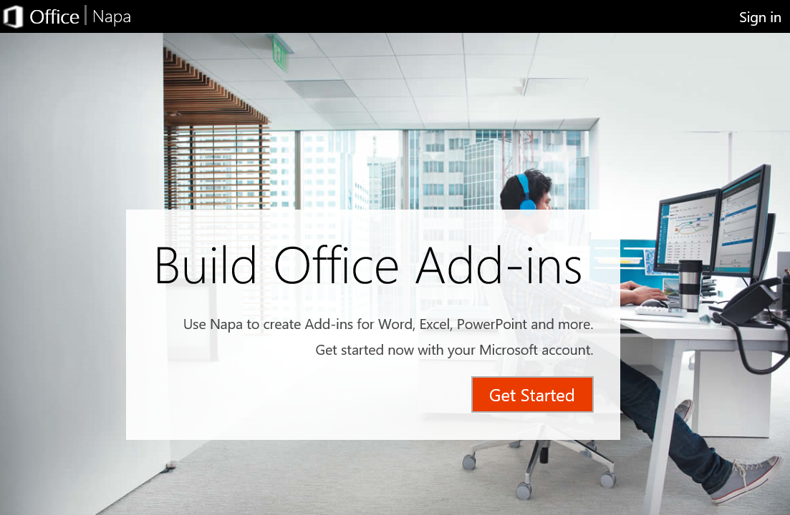
Development options Napa
Getting started
In-browser web editor for building client-side Office add-ins
Uses Office Online and OneDrive for file storage
Intellisense for JavaScript and HTML5
Allows for sharing and exporting
Doesn’t expose full add-in manifest

Slide 23

Development options Visual Studio
Getting started
First-class development experience with templates and debugging
Exposes the full add-in manifest and automated deployment commands
Allows for web projects containing both client-side and server-side assets

Slide 24

Development options Other
Getting started
You can use anything that delivers for the web
Microsoft offering Yeoman generator for skeleton add-in project
Keep in mind that add-ins need SSL/HTTPS

Slide 25

Office UI Fabric
Getting started
Responsive, mobile-first, front-end framework for developers that delivers instant look and feel of Office
Handles typography, color, icons, animations, responsive grid layouts, and localization

Slide 26
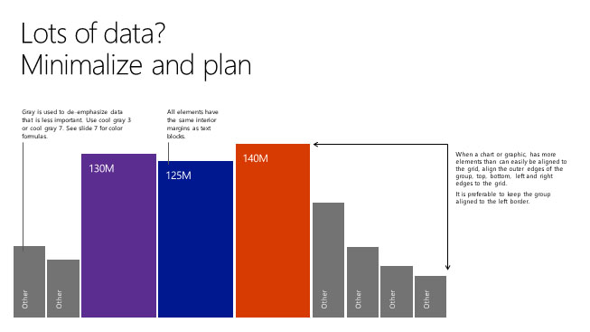
Demo Building your first Office add-in
Getting started

Slide 27






Add-in roadmap
Getting started
 | Win32 | Online | iPad | iPhone | Mac | Android | UWA
 |  |  |  |  | Read
 |  |  |  |  | Compose
 |  | APIs
 |  | View
 |  | Edit
Today
Next
Backlog
Notes:
ROBLE

Slide 28
Conclusion
Surface your business solutions in Office 365 user interface
Leverage the building blocks of the platform
Use the development platform of your choice

Slide 29
Summary
Intro the add-in model
Office add-ins
Getting started

Slide 30
Further reading…
Getting Started with Office add-ins
Office add-in Code Samples
Office add-in Training videos & hands on labs
Office add-in Snack videos
Office add-in documentation

Slide 31
Developer Program launch
1 YEAR FREE
E-mail Newsletters
Free Developer Subscription
Free Training
Free Tools
Webinars
http://dev.office.com/devprogram

Slide 32


Engage
Office 365 Network
https://www.yammer.com/itpronetwork
Twitter
S
S
t
t
a
a
r
r
t
t
@OfficeDev
Stack overflow
[ms-office]
Channel 9 Dev Show
http://aka.ms/O365DevShow
Podcasts http://dev.office.com/podcasts
Snack Demos
http://aka.ms/o365DevSnackDemos
UserVoice
http://officespdev.uservoice.com/

Slide 33

Thank you sponsors!

Slide 34

Please visit our sponsors who made this day possible!
Rate this session with the event app (and win a Lego VW Bully)
http://app.spsmuc.com

Slide 35
Thank you

